Slide 1
Introduction to Topic Modeling
Neal Audenaert
neala@tamu.edu
Texas Center for Applied Technology

Slide 2
Agenda
Overview
Factory Metaphor
Statistical Model
Remarks

Slide 3
What is Topic Modeling
Family of statistical techniques for analyzing corpora that
Represents the structure of relationships within and between documents
Provides methods for automatically organizing, understanding, searching and summarizing
LDA – Latent Dirichlet Allocation
First and most widely used technique
Unsupervised clustering of words into topics
Foundation for more complex models
Notes:
In this paper we consider the problem of modeling text corpora and other collections of discrete data. The goal is to find short descriptions of the members of a collection that enable efficient processing of large collections while preserving the essential statistical relationships that are useful for basic tasks such as classification, novelty detection, summarization, and similarity and relevance judgments.

Slide 4
From David Blei (2012) Probabilistic Topic Models, MLSS Slides
Notes:
Fix this slide . . . need to break out bits and add animations

Slide 5
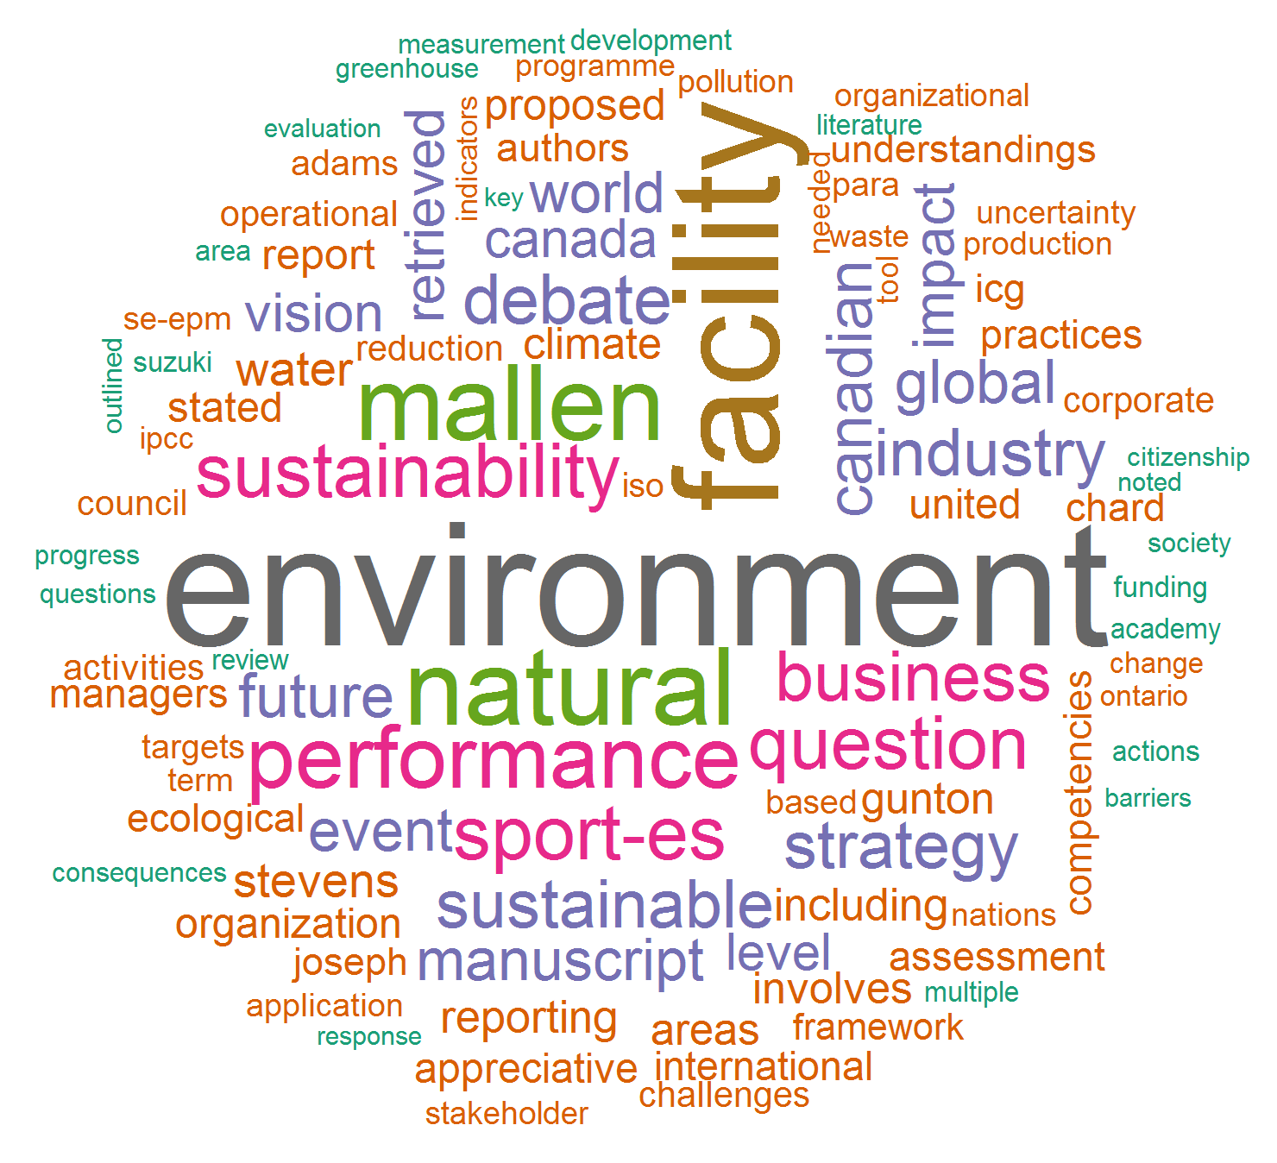

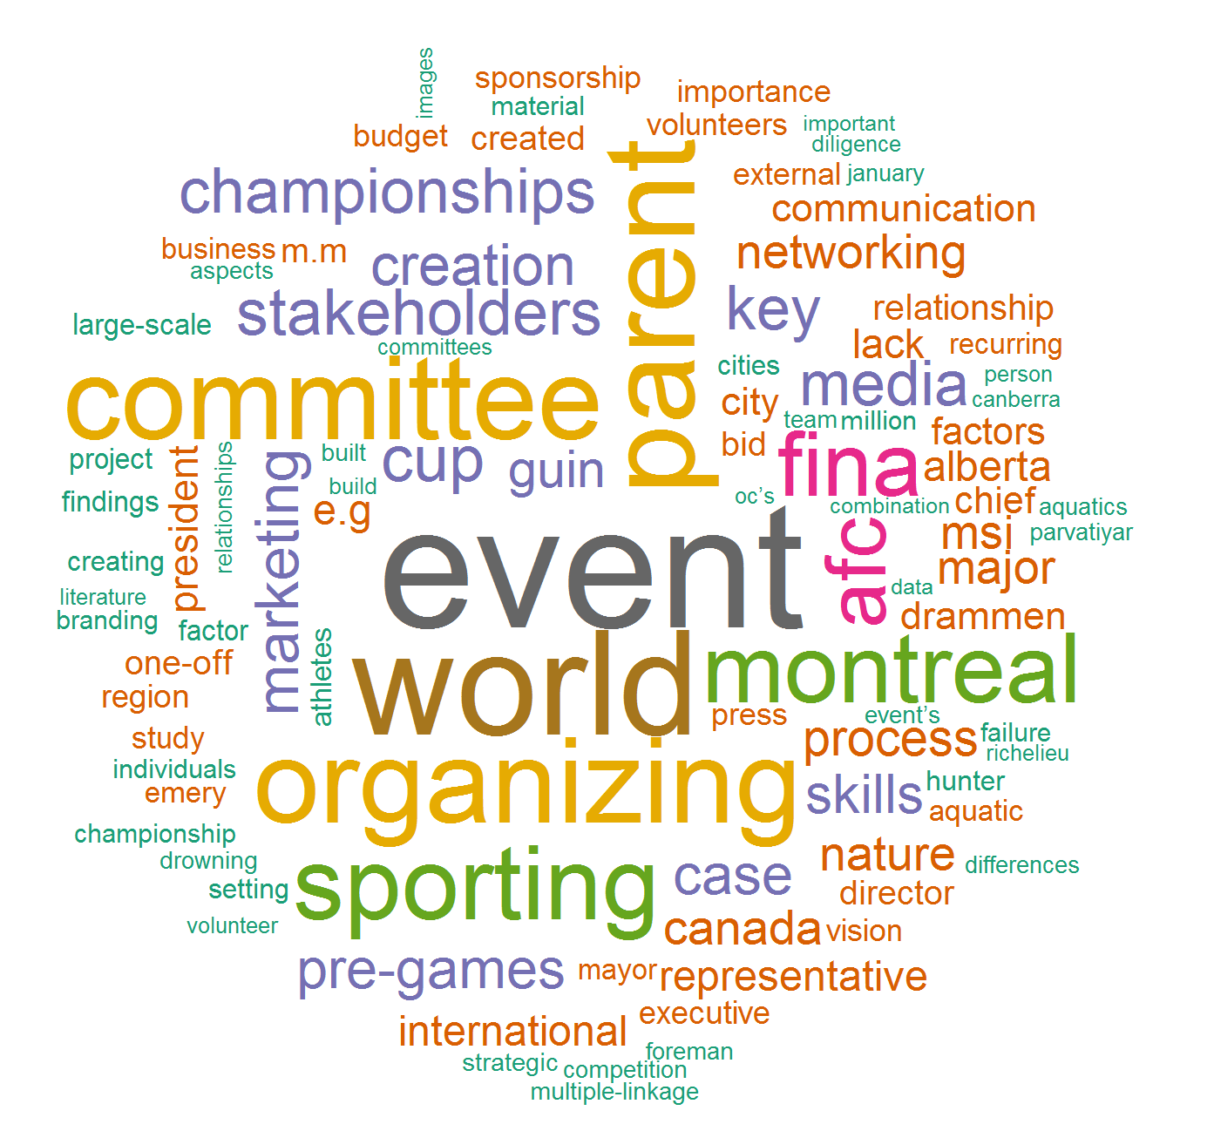




Slide 6
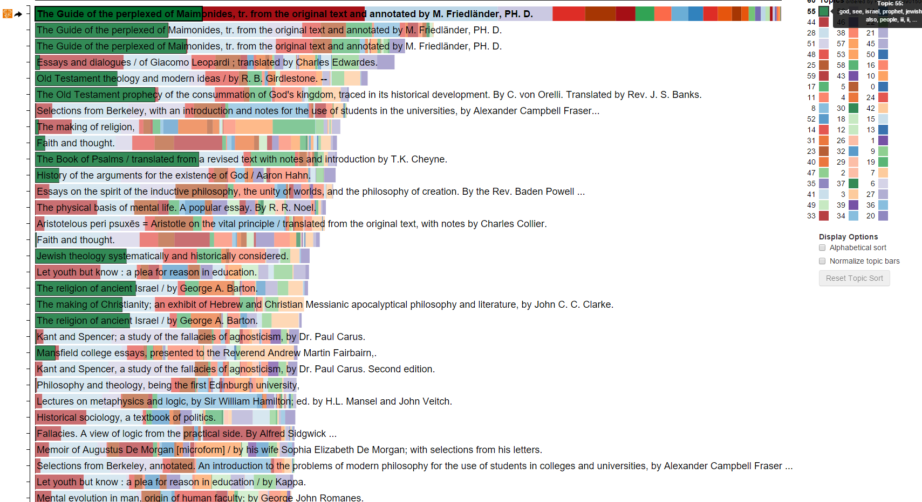
Jaimie Murdoc. InPho Topic Explorer (accessed Jan 2016) http://inphodata.cogs.indiana.edu/

Slide 7
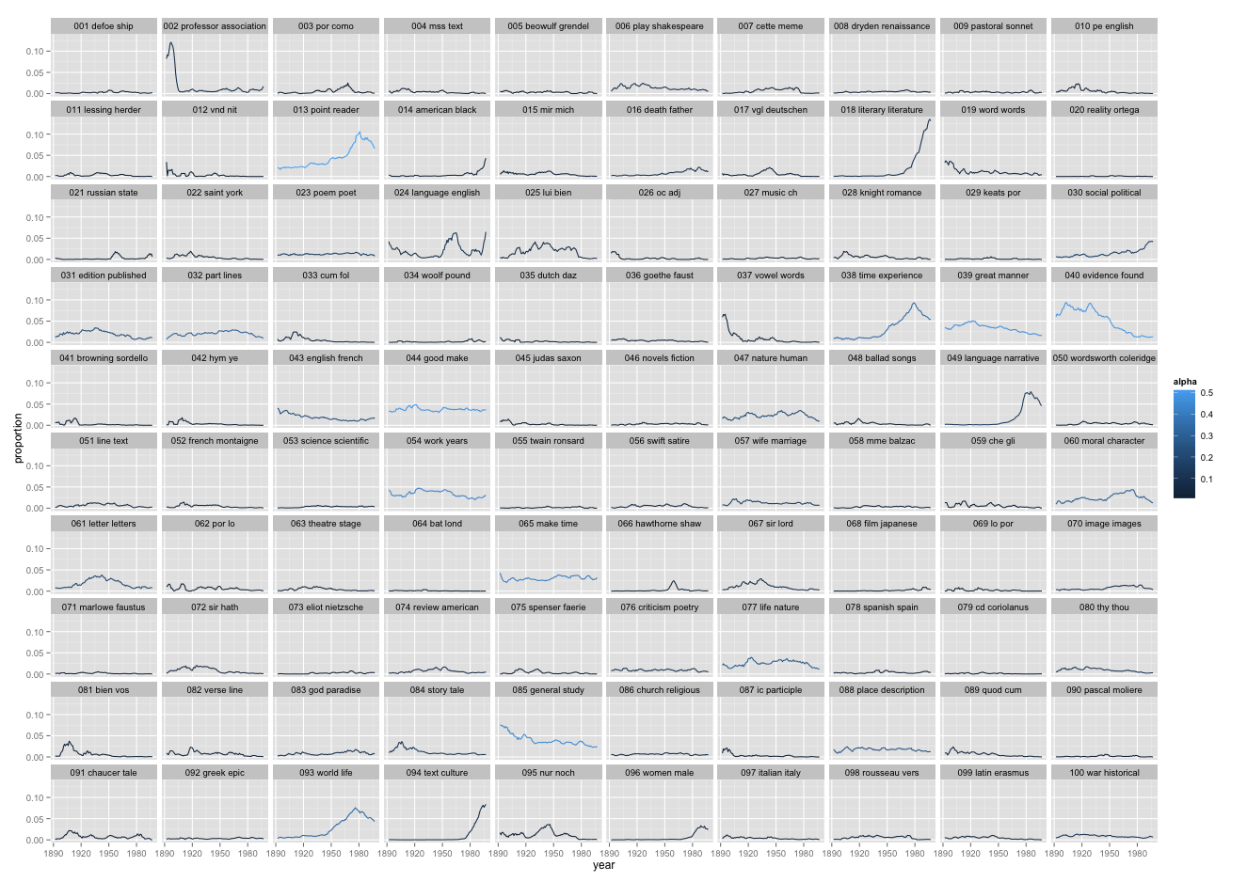
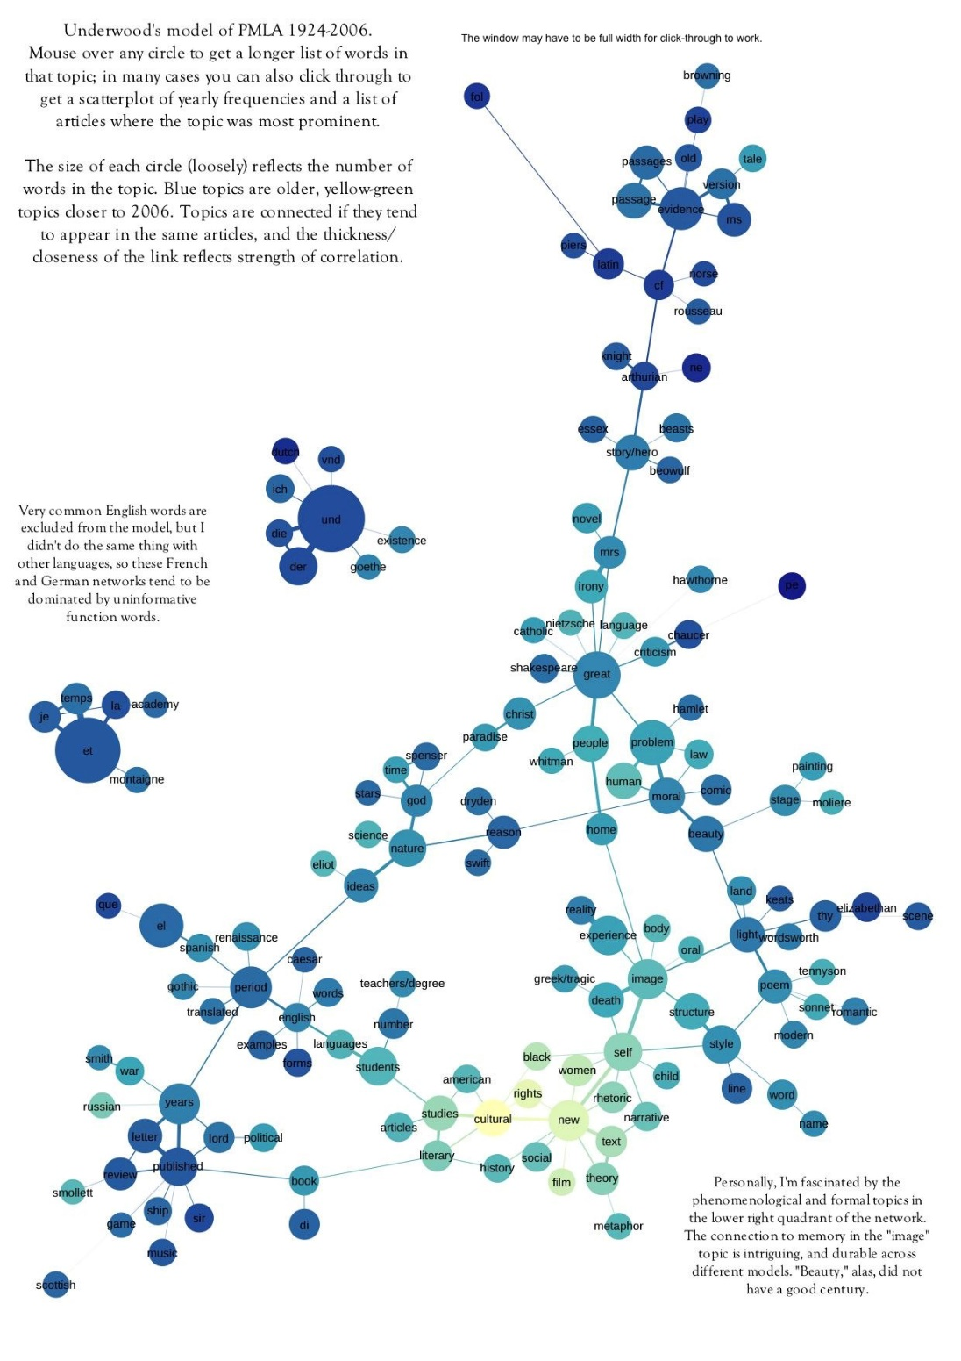
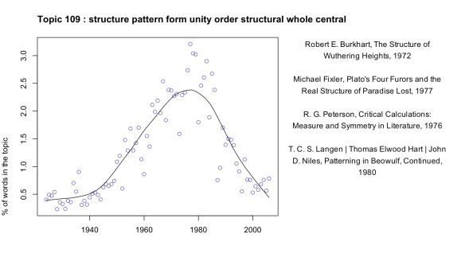
Andrew Goldstone and Ted Underwood (2012). What can topic models of PMLA teach us about the history of literary scholarhip
http://tedunderwood.com/2012/12/14/what-can-topic-models-of-pmla-teach-us-about-the-history-of-literary-scholarship/

Slide 8
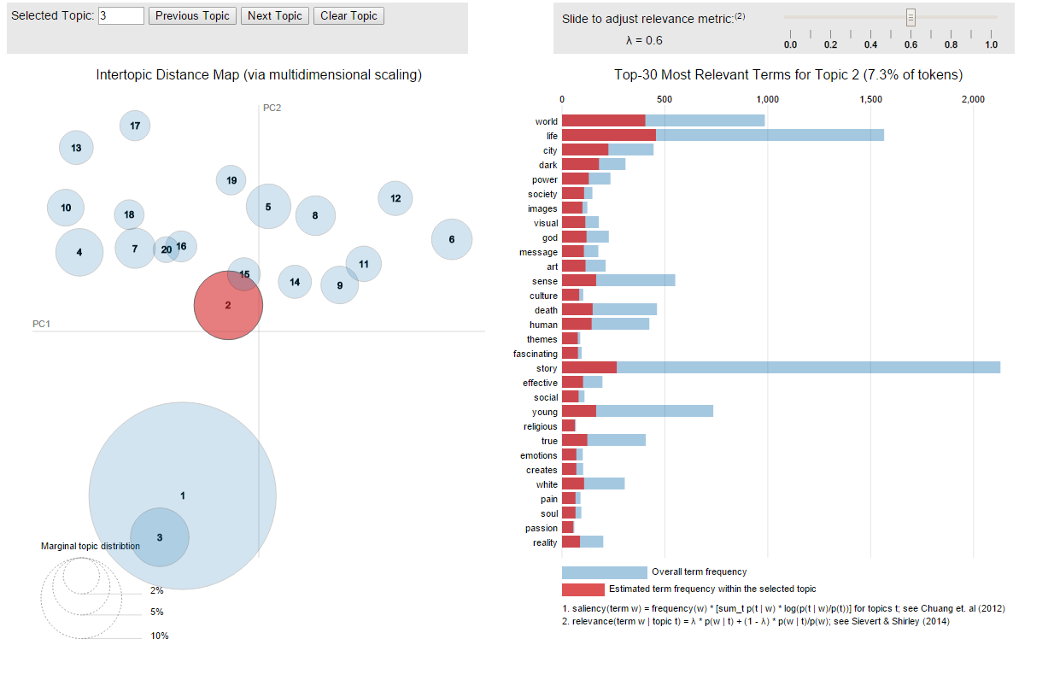
Carson Sievert, Kenneth E Shirley (2014) LDAVis: A Method for Visualizing and Interpreting Documents.
http://cpsievert.github.io/LDAvis/reviews/vis/#topic=3&lambda=0.6&term=

Slide 9



The Parable of the Factory
What’s going on here?
Document factory produces some well-defined set of documents (19th C. novels, Victorian poetry, AP articles, letters of Margaret Sanger)
The process of creating these documents is a trade secret of the factory that we’d like to reverse engineer to figure out what’s going on
The only evidence we have is the documents that the factory produces and our theory about what is happening inside
Document Factory
Notes:
Source:
http://all-free-download.com/free-vector/factory-building-clip-art.html
https://en.wikipedia.org/wiki/Trash_(computing)
http://www.clipartbest.com/recycling-bin-s
https://pixabay.com/en/miner-trolley-worker-mine-lorry-23167/

Slide 10


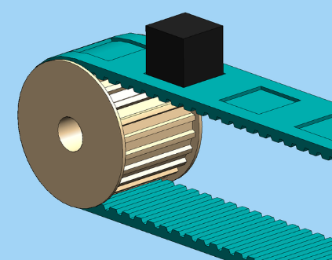
Big ‘ol Bucket of Words
What’s going on here?
whale
vampire
squid
sailing
whale
perance
vampire
squid
Document Factory
Notes:
Advantage: Easy to compute – just count the words
Disadvantage: Not too useful
Notes:
Produces a probability distribution function (PDF) of all words produced by this factory
Models the intuition that some words are used more frequently than others
Minimal representation of internal structure
Might use, for example, fast, predictive type-ahead on a mobile phone
Note, bag of words, we are really ignoring the order of words and all that stuff that literature folks care about. For our purpose, all we care about is the fact that some mole grabbed a bunch of words at random and threw them in a cart.
We might try calling the factory worker an author. In practice, since we have some experience with how document factories work, we assume that it probably isn’t a mole. More likely a small army of graduate students in cubicles. But at this stage, for our purposes, we may as well assume it is moles.

Slide 11
Buckets of Words
What’s going on here?
sailing
whale
whale
perance
vampire
squid
vampire
squid
sailing
whale
sailing
whale
perance
vampire
perance
vampire
squid
squid
Document Factory
Notes:
To add a bit of complexity, we notice that words don’t seem to show up randomly. We can see that some groups of documents seem to use similar words.
We will theorize that, instead of one bucket, there are actually several different buckets. The factory worker first selects a bucket, and then pulls out a bunch of words.
These buckets can be thought of, roughly, as topics or themes and different documents are about different topics (but only one).
This model is harder to learn – notice in particular that we’ll need to guess how many different buckets there are inside and infer the frequency of words in each bucket. This is still pretty easy to do. For example, if somehow we knew which documents came from a single bucket, we can still just count up the words in all of those documents (there are techniques to do this automatically).
As a benefit, we model some notion of the internal structure. We can talk about how different words are used in different topics, we can group documents together, and when a new document comes out the door, we can make an educated guess about which bucket it came from.

Slide 12

Buckets of Buckets of Words
What’s going on here?
sailing
whale
whale
perance
vampire
squid
vampire
squid
sailing
whale
sailing
whale
perance
vampire
perance
vampire
squid
squid
Document Factory
Notes:
For our final tweak, we will notice that document’s aren’t about just one thing. For example, it might be mostly about Elizabeth Gaskell’s North and South, but also touch on ideas of shifting religious attitudes and industrialization.
To account for this, instead of confining our mole to pick from one bin, he makes a stop by each different bin and picks up words, more from some and fewer (perhaps none) from others. These words get packaged up as a document and shipped out the door.
Now, we have a much more complex model. We still need to learn what is in each of the buckets (the PDFs that define our topics). But in order to do that, we have to learn what documents are about what topics, in what proportions, and we have to learn what individual words in the documents are associated with which topic (because, the word bank might be associated with more than one topic even within the same document).
Again, the only information we have to learn this model, is the documents that we see getting produced by the factory. This is a reasonably complex process, but is, for the most part, a detail that we can ignore.

Slide 13
The Parable Explained
Hidden vs. observed structure
Buckets are probability distributions over a vocabulary
Documents are multinomials
Choice of a bucket yields a conditional probability
Selection of multiple buckets yields a mixture model
Notes:
This parable is simple (perhaps simplistic) but it introduces some key concepts in topic models

Slide 14
Statistical Model – The mathematical structure of the model expressed as a probability function (a posterior)
Trained Model – A
Training Set – A set of document that we use

Slide 15
Formalizing the Model

Slide 16
From David Blie (2012) Probabilistic Topic Models, MLSS Slides
Notes:
Fix this slide . . . need to break out bits and add animations

Slide 17
Objectives
Intuition
Assumptions
There are topics
Words are used differently (i.e., with different frequency) in different topics
Documents can be about multiple topics
Documents are bags of words
Topics are fixed and finite
Topics are independent
Documents are independent

Slide 18
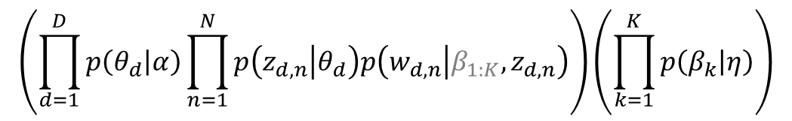

In the next few slides, we will walk through the generative statistical model behind LDA. Note that this is the model that is to be learned; we assume that we have already trained the model using a tool like Mallet.
The main purpose for walking through this detail is both to make the underlying math explicit and to show how that relates to our intuitions.
α
θ_{d}
z_{dn}
w_{dn}
β_{k}
η
N
D
K
$$\left(\prod_{d=1}^{D}{p\left(θ_{d} | α\right)}\prod_{n=1}^{N}{p\left(z_{d, n} | θ_{d}\right)p\left(w_{d, n} | β_{1:K},z_{d, n}\right)}\right)\left(\prod_{k=1}^{K}{p\left(β_{k} | η\right)}\right)$$
$$p\left(β, θ, z, w\right)=$$
Notes:
Introduce generative model (i.e. this corresponds to our mental model of what is going on in the factory)

Slide 19
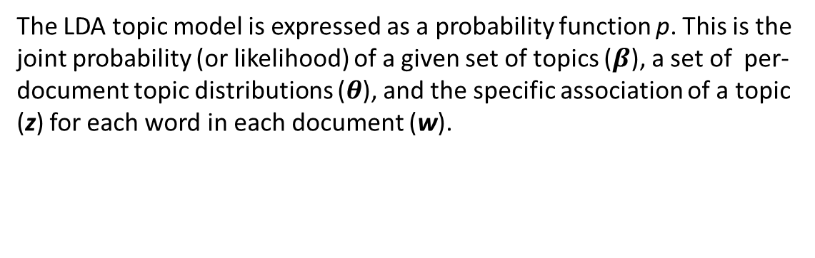

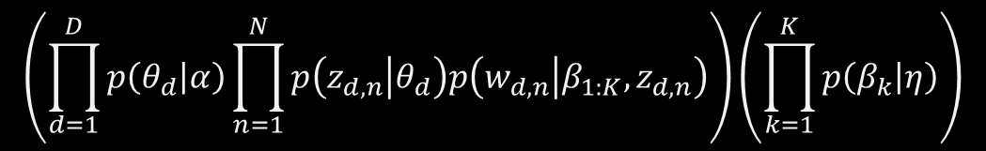
The LDA topic model is expressed as a probability function p. This is the joint probability (or likelihood) of a given set of topics ($β$), a set of per-document topic distributions ($θ$), and the specific association of a topic (z) for each word in each document (w).
α
θ_{d}
z_{dn}
w_{dn}
β_{k}
η
N
D
K
$$\left(\prod_{d=1}^{D}{p\left(θ_{d} | α\right)}\prod_{n=1}^{N}{p\left(z_{d, n} | θ_{d}\right)p\left(w_{d, n} | β_{1:K},z_{d, n}\right)}\right)\left(\prod_{k=1}^{K}{p\left(β_{k} | η\right)}\right)$$
$$p\left(β, θ, z, w\right)=$$
Notes:
Note that the model is the probability function.
We learn this probability function from the observed data (the words in the document) using a tool like Mallet.
Once learned, we can use the results in interesting ways

Slide 20
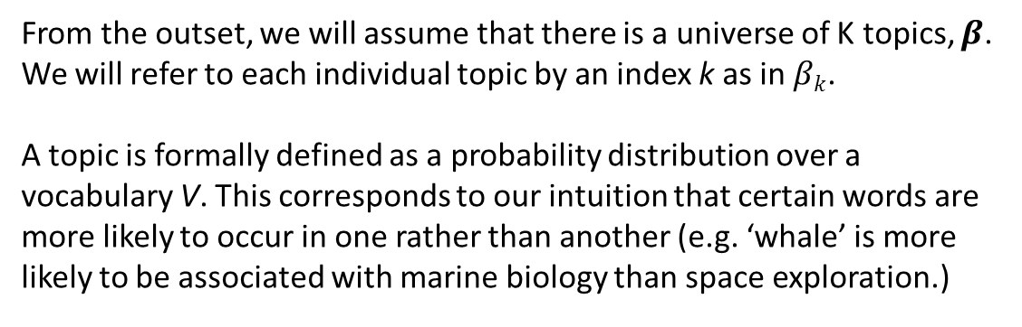
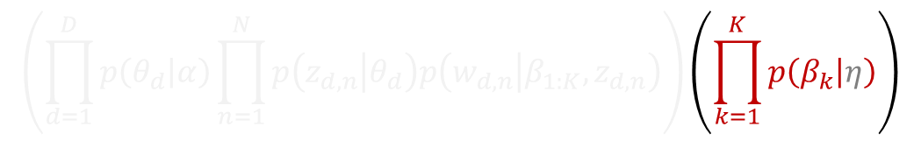
From the outset, we will assume that there is a universe of K topics, $β$. We will refer to each individual topic by an index k as in $βk$.
A topic is formally defined as a probability distribution over a vocabulary V. This corresponds to our intuition that certain words are more likely to occur in one rather than another (e.g. ‘whale’ is more likely to be associated with marine biology than space exploration.)
α
θ_{d}
z_{dn}
w_{dn}
β_{k}
η
N
D
K
$$\left(\prod_{d=1}^{D}{p\left(θ_{d} | α\right)}\prod_{n=1}^{N}{p\left(z_{d, n} | θ_{d}\right)p\left(w_{d, n} | β_{1:K},z_{d, n}\right)}\right)\left(\prod_{k=1}^{K}{p\left(β_{k} | η\right)}\right)$$
$$p\left(β, θ, z, w\right)=$$
Notes:
Introduce plate notation. – Circle is a variable in our model (corresponds to p($βk$). Box is repetition, corresponds to product.

Slide 21
These aren’t really topics. They are PDFs over a vocabulary. We can (and should) argue over what a “topic” really is in our model.
“We refer to the latent multinomial variables in the LDA model as topics, so as to exploit text-oriented intuitions, but we make no epistemological claims regarding these latent variables beyond their utility in representing probability distributions on sets of words.”
– Blei, 2003
α
θ_{d}
z_{dn}
w_{dn}
β_{k}
η
N
D
K
$$\left(\prod_{d=1}^{D}{p\left(θ_{d} | α\right)}\prod_{n=1}^{N}{p\left(z_{d, n} | θ_{d}\right)p\left(w_{d, n} | β_{1:K},z_{d, n}\right)}\right)\left(\prod_{k=1}^{K}{p\left(β_{k} | η\right)}\right)$$
$$p\left(β, θ, z, w\right)=$$
Notes:
Highlight difference between a common place notion of a topic and the need to represent that intuition mathematically so that it becomes computationally tractable.

Slide 22
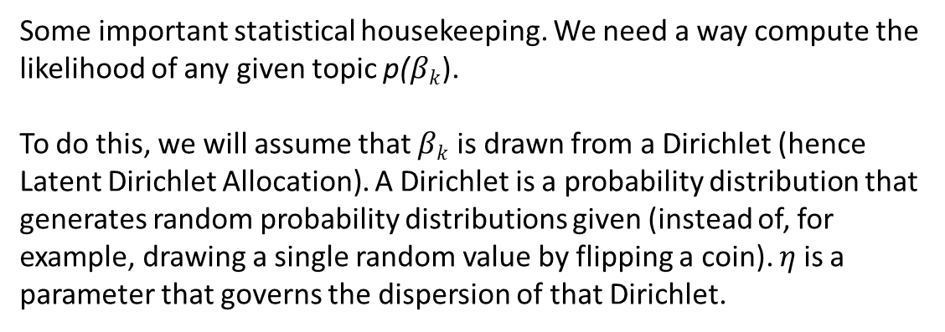
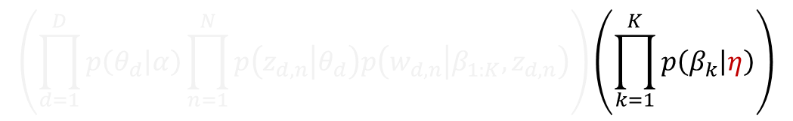
Some important statistical housekeeping. We need a way compute the likelihood of any given topic p($βk$).
To do this, we will assume that $βk$ is drawn from a Dirichlet (hence Latent Dirichlet Allocation). A Dirichlet is a probability distribution that generates random probability distributions given (instead of, for example, drawing a single random value by flipping a coin). 𝜂 is a parameter that governs the dispersion of that Dirichlet.
α
θ_{d}
z_{dn}
w_{dn}
β_{k}
η
N
D
K
$$\left(\prod_{d=1}^{D}{p\left(θ_{d} | α\right)}\prod_{n=1}^{N}{p\left(z_{d, n} | θ_{d}\right)p\left(w_{d, n} | β_{1:K},z_{d, n}\right)}\right)\left(\prod_{k=1}^{K}{p\left(β_{k} | η\right)}\right)$$
$$p\left(β, θ, z, w\right)=$$

Slide 23
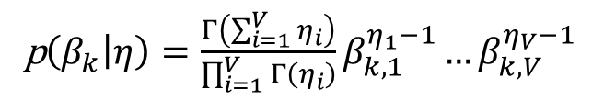
In case you were wondering.
p$\left(β_{k} | η\right)=\frac{Γ\left(\sum_{i=1}^{V}{η_{i}}\right)}{\prod_{i=1}^{V}{Γ\left(η_{i}\right)}}β_{k,1}^{η_{1}−1}…β_{k,V}^{η_{V}−1}$
α
θ_{d}
z_{dn}
w_{dn}
β_{k}
η
N
D
K
$$\left(\prod_{d=1}^{D}{p\left(θ_{d} | α\right)}\prod_{n=1}^{N}{p\left(z_{d, n} | θ_{d}\right)p\left(w_{d, n} | β_{1:K},z_{d, n}\right)}\right)\left(\prod_{k=1}^{K}{p\left(β_{k} | η\right)}\right)$$
$$p\left(β, θ, z, w\right)=$$

Slide 24
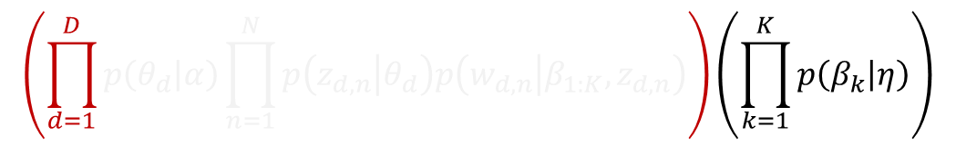
With this universe of topics, we can start generating documents.
For each document d
α
θ_{d}
z_{dn}
w_{dn}
β_{k}
η
N
D
K
$$\left(\prod_{d=1}^{D}{p\left(θ_{d} | α\right)}\prod_{n=1}^{N}{p\left(z_{d, n} | θ_{d}\right)p\left(w_{d, n} | β_{1:K},z_{d, n}\right)}\right)\left(\prod_{k=1}^{K}{p\left(β_{k} | η\right)}\right)$$
$$p\left(β, θ, z, w\right)=$$
Notes:
In English, choose the topics that we will write about.
Note the mapping of α to our understanding of how many topics a given document is likely to discuss.

Slide 25
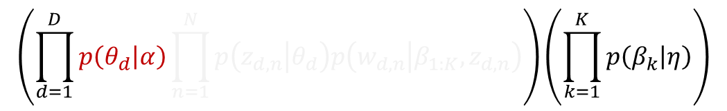
With this universe of topics, we can start generating documents.
For each document d
Step 1: Choose θ_{d} ~ Dir(α)
α
θ_{d}
z_{dn}
w_{dn}
β_{k}
η
N
D
K
$$\left(\prod_{d=1}^{D}{p\left(θ_{d} | α\right)}\prod_{n=1}^{N}{p\left(z_{d, n} | θ_{d}\right)p\left(w_{d, n} | β_{1:K},z_{d, n}\right)}\right)\left(\prod_{k=1}^{K}{p\left(β_{k} | η\right)}\right)$$
$$p\left(β, θ, z, w\right)=$$
Notes:
In English, choose the topics that we will write about.
Note the mapping of α to our understanding of how many topics a given document is likely to discuss.

Slide 26
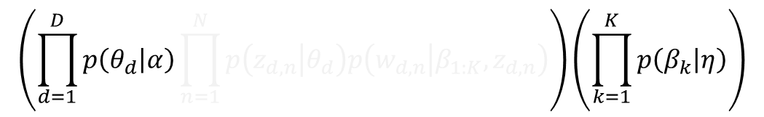
With this universe of topics, we can start generating documents.
For each document d
Step 1: Choose θ_{d} ~ Dir(α)
θ_{d} is a PDF that describes how a document relates to each topic
α is a hyperparameter that controls about how θ_{d} is distributed
α
θ_{d}
z_{dn}
w_{dn}
β_{k}
η
N
D
K
$$\left(\prod_{d=1}^{D}{p\left(θ_{d} | α\right)}\prod_{n=1}^{N}{p\left(z_{d, n} | θ_{d}\right)p\left(w_{d, n} | β_{1:K},z_{d, n}\right)}\right)\left(\prod_{k=1}^{K}{p\left(β_{k} | η\right)}\right)$$
$$p\left(β, θ, z, w\right)=$$
Notes:
In English, choose the topics that we will write about.
Note the mapping of α to our understanding of how many topics a given document is likely to discuss.

Slide 27
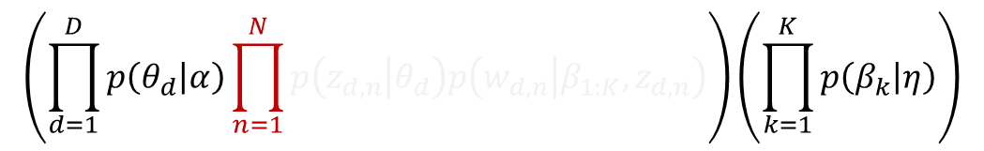
With this universe of topics, we can start generating documents.
For each document d
Step 1: Choose θ_{d} ~ Dir(α)
For each word w_{dn} in document d
α
θ_{d}
z_{dn}
w_{dn}
β_{k}
η
N
D
K
$$\left(\prod_{d=1}^{D}{p\left(θ_{d} | α\right)}\prod_{n=1}^{N}{p\left(z_{d, n} | θ_{d}\right)p\left(w_{d, n} | β_{1:K},z_{d, n}\right)}\right)\left(\prod_{k=1}^{K}{p\left(β_{k} | η\right)}\right)$$
$$p\left(β, θ, z, w\right)=$$

Slide 28
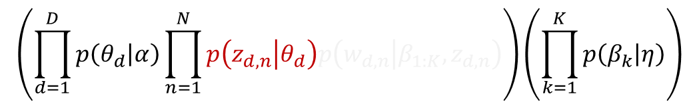
With this universe of topics, we can start generating documents.
For each document d
Step 1: Choose θ_{d} ~ Dir(α)
For each word w_{dn} in the document
Step 2: Choose a topic z_{dn} ~ Multinomial(θ_{d})
α
θ_{d}
z_{dn}
w_{dn}
β_{k}
η
N
D
K
$$\left(\prod_{d=1}^{D}{p\left(θ_{d} | α\right)}\prod_{n=1}^{N}{p\left(z_{d, n} | θ_{d}\right)p\left(w_{d, n} | β_{1:K},z_{d, n}\right)}\right)\left(\prod_{k=1}^{K}{p\left(β_{k} | η\right)}\right)$$
$$p\left(β, θ, z, w\right)=$$

Slide 29
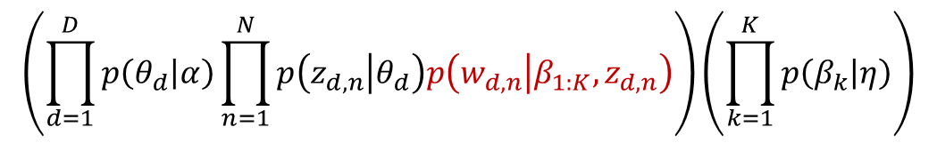
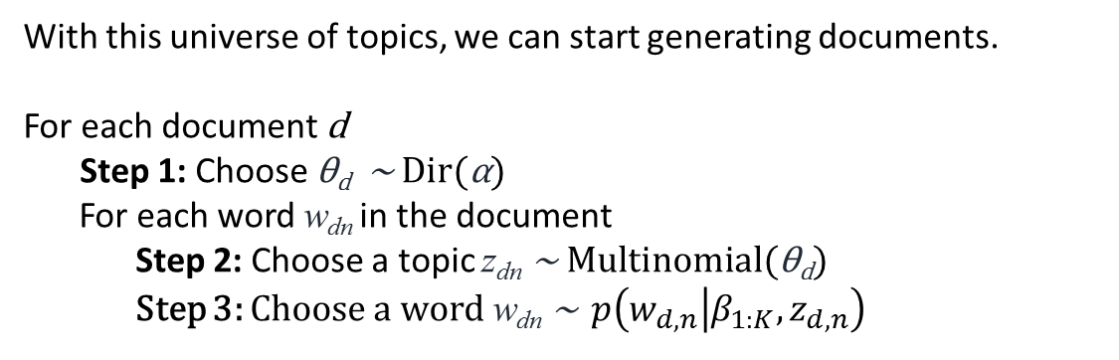
With this universe of topics, we can start generating documents.
For each document d
Step 1: Choose θ_{d} ~ Dir(α)
For each word w_{dn} in the document
Step 2: Choose a topic z_{dn} ~ Multinomial(θ_{d})
Step 3: Choose a word w_{dn} ~ $p\left(w_{d, n} | β_{1:K},z_{d, n}\right)$
α
θ_{d}
z_{dn}
w_{dn}
β_{k}
η
N
D
K
$$\left(\prod_{d=1}^{D}{p\left(θ_{d} | α\right)}\prod_{n=1}^{N}{p\left(z_{d, n} | θ_{d}\right)p\left(w_{d, n} | β_{1:K},z_{d, n}\right)}\right)\left(\prod_{k=1}^{K}{p\left(β_{k} | η\right)}\right)$$
$$p\left(β, θ, z, w\right)=$$

Slide 30
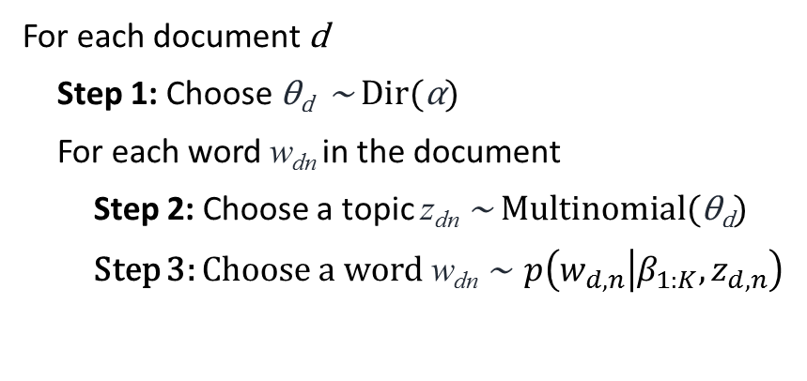
Translation
For each document d
Step 1: Choose θ_{d} ~ Dir(α)
For each word w_{dn} in the document
Step 2: Choose a topic z_{dn} ~ Multinomial(θ_{d})
Step 3: Choose a word w_{dn} ~ $p\left(w_{d, n} | β_{1:K},z_{d, n}\right)$
An author starts writing a document
Step 1: She picks something to write about
She writes words on the page by
Step 2: Choosing the topic for this word
Step 3: Picking a word related to that topic

Slide 31
Our statistical model consists of:
Per-Document Topic Assignments
Per-Word Topic Assignments
A set of topics
PDF over a vocabulary
Finite and universal
α
θ_{d}
z_{dn}
w_{dn}
β_{k}
η
N
D
K
Words
Documents
Corpus

Slide 32
The only data we actually have are the individual words and the documents they appear in. From that rather minimal starting point, we have to infer all the other parameters in the model.
Latent Variables
Per-Document Topic Assignments
Per-Word Topic Assignments
A set of topics
PDF over a vocabulary
Finite and universal
α
θ_{d}
z_{dn}
w_{dn}
β_{k}
η
N
D
K
Observed Variables
Words
Documents
Corpus

Slide 33
We started by saying this modeled our assumptions about documents.
There are a fixed number of topics.
Topics are defined by word use (i.e., a given word is more likely to be associated with one topic than another)
Topics are fixed, finite and universal
Documents can be about more than one topic, in different proportions
Words are discrete units of information (stemming, stopping)
Each word relates to exactly one topic
How focused are the documents
How many words will have high-probability
α
θ_{d}
z_{dn}
w_{dn}
β_{k}
η
N
D
K
The only relevant fact about documents is the words they contain. (ignore author, time period, journal, quality, etc.)
Documents are bags of words.

Slide 34
Questions and Discussion

Slide 35
Next Time
Please read the programming historian’s intro to Mallet
Download and install Mallet
Download and install RStudio

Slide 36
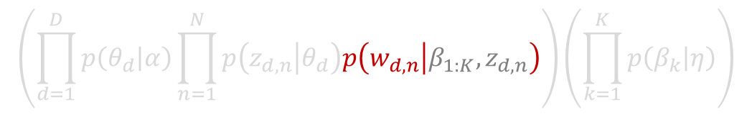
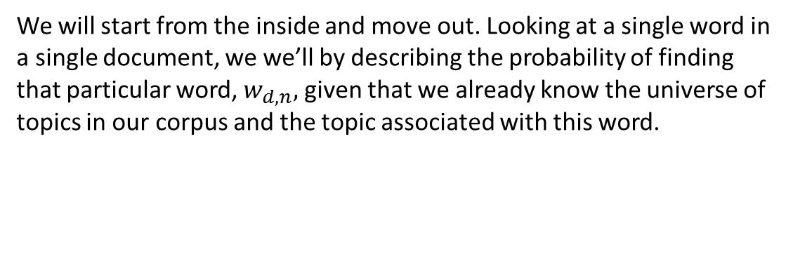

We will start from the inside and move out. Looking at a single word in a single document, we we’ll by describing the probability of finding that particular word, $w_{d, n},$ given that we already know the universe of topics in our corpus and the topic associated with this word.
w_{dn}
$$\left(\prod_{d=1}^{D}{p\left(θ_{d} | α\right)}\prod_{n=1}^{N}{p\left(z_{d, n} | θ_{d}\right)p\left(w_{d, n} | β_{1:K},z_{d, n}\right)}\right)\left(\prod_{k=1}^{K}{p\left(β_{k} | η\right)}\right)$$
$$p\left(β, θ, z, w\right)=$$

Slide 37
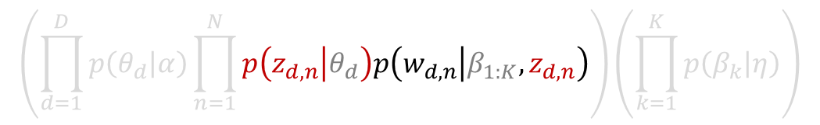
We have given the intuition behind this approach to topic modeling, now we need to state that intuition in a mathematically precise way so that we can compute it.
To do this, we will turn to generative Bayesian statistics.
z_{dn}
w_{dn}
$$\left(\prod_{d=1}^{D}{p\left(θ_{d} | α\right)}\prod_{n=1}^{N}{p\left(z_{d, n} | θ_{d}\right)p\left(w_{d, n} | β_{1:K},z_{d, n}\right)}\right)\left(\prod_{k=1}^{K}{p\left(β_{k} | η\right)}\right)$$
$$p\left(β, θ, z, w\right)=$$

Slide 38
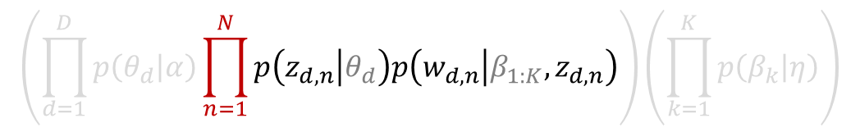
We have given the intuition behind this approach to topic modeling, now we need to state that intuition in a mathematically precise way so that we can compute it.
To do this, we will turn to generative Bayesian statistics.
z_{dn}
w_{dn}
N
$$\left(\prod_{d=1}^{D}{p\left(θ_{d} | α\right)}\prod_{n=1}^{N}{p\left(z_{d, n} | θ_{d}\right)p\left(w_{d, n} | β_{1:K},z_{d, n}\right)}\right)\left(\prod_{k=1}^{K}{p\left(β_{k} | η\right)}\right)$$
$$p\left(β, θ, z, w\right)=$$

Slide 39
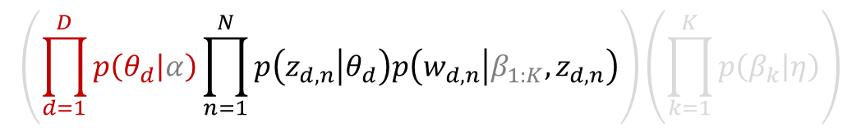
We have given the intuition behind this approach to topic modeling, now we need to state that intuition in a mathematically precise way so that we can compute it.
To do this, we will turn to generative Bayesian statistics.
θ_{d}
z_{dn}
w_{dn}
N
D
$$\left(\prod_{d=1}^{D}{p\left(θ_{d} | α\right)}\prod_{n=1}^{N}{p\left(z_{d, n} | θ_{d}\right)p\left(w_{d, n} | β_{1:K},z_{d, n}\right)}\right)\left(\prod_{k=1}^{K}{p\left(β_{k} | η\right)}\right)$$
$$p\left(β, θ, z, w\right)=$$

Slide 40
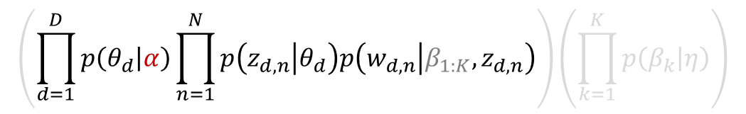
We have given the intuition behind this approach to topic modeling, now we need to state that intuition in a mathematically precise way so that we can compute it.
To do this, we will turn to generative Bayesian statistics.
α
θ_{d}
z_{dn}
w_{dn}
N
D
$$\left(\prod_{d=1}^{D}{p\left(θ_{d} | α\right)}\prod_{n=1}^{N}{p\left(z_{d, n} | θ_{d}\right)p\left(w_{d, n} | β_{1:K},z_{d, n}\right)}\right)\left(\prod_{k=1}^{K}{p\left(β_{k} | η\right)}\right)$$
$$p\left(β, θ, z, w\right)=$$

Slide 41
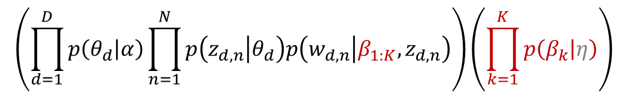
We have given the intuition behind this approach to topic modeling, now we need to state that intuition in a mathematically precise way so that we can compute it.
To do this, we will turn to generative Bayesian statistics.
α
θ_{d}
z_{dn}
w_{dn}
β_{k}
N
D
K
$$\left(\prod_{d=1}^{D}{p\left(θ_{d} | α\right)}\prod_{n=1}^{N}{p\left(z_{d, n} | θ_{d}\right)p\left(w_{d, n} | β_{1:K},z_{d, n}\right)}\right)\left(\prod_{k=1}^{K}{p\left(β_{k} | η\right)}\right)$$
$$p\left(β, θ, z, w\right)=$$

Slide 42
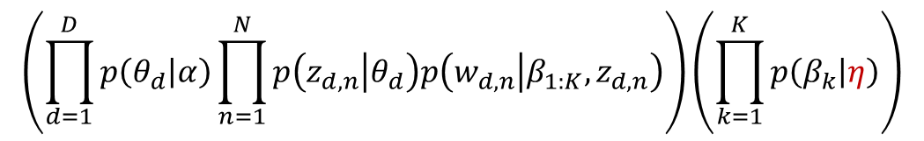
We have given the intuition behind this approach to topic modeling, now we need to state that intuition in a mathematically precise way so that we can compute it.
To do this, we will turn to generative Bayesian statistics.
α
θ_{d}
z_{dn}
w_{dn}
β_{k}
η
N
D
K
$$\left(\prod_{d=1}^{D}{p\left(θ_{d} | α\right)}\prod_{n=1}^{N}{p\left(z_{d, n} | θ_{d}\right)p\left(w_{d, n} | β_{1:K},z_{d, n}\right)}\right)\left(\prod_{k=1}^{K}{p\left(β_{k} | η\right)}\right)$$
$$p\left(β, θ, z, w\right)=$$

Slide 43
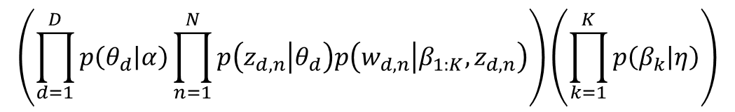
We have given the intuition behind this approach to topic modeling, now we need to state that intuition in a mathematically precise way so that we can compute it.
To do this, we will turn to generative Bayesian statistics.
α
θ_{d}
z_{dn}
w_{dn}
β_{k}
η
N
D
K
$$\left(\prod_{d=1}^{D}{p\left(θ_{d} | α\right)}\prod_{n=1}^{N}{p\left(z_{d, n} | θ_{d}\right)p\left(w_{d, n} | β_{1:K},z_{d, n}\right)}\right)\left(\prod_{k=1}^{K}{p\left(β_{k} | η\right)}\right)$$
$$p\left(β, θ, z, w\right)=$$

